Slide 1
RESEARCH PROJECT REPORT IN FULFILMENT OF SUMMER INTERNSHIP PROJECT
TOPIC:
INPUT TAX CREDIT
SUBMITTED BY: SUBMITTED TO:
Saniya Usmani Shashwat Singhal

Slide 2
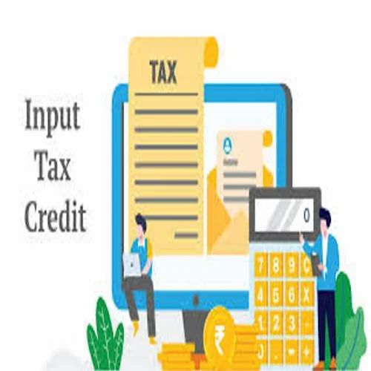
Input Tax Credit
Input Tax Credit refers to the credit that a registered taxpayer can claim for GST paid on purchases of goods and services used in the course or furtherance of business. The taxpayer can utilize this credit to offset GST liability on outward supplies.

Slide 3
Objectives of Input Tax Credit
Elimination of Cascading Effect
Promotion of Business Efficiency
Encouragement of Tax Compliance
Improved Revenue Collection

Slide 4
Legal Framework of ITC
Relevant Provisions
The Input Tax Credit mechanism is governed primarily by:
Section 16 of the CGST Act, 2017
Section 17 of the CGST Act, 2017
Section 18 of the CGST Act, 2017
Section 49 relating to utilization of credit
CGST Rules, 2017

Slide 5
Definition of Input Tax
Input tax includes:
Central GST (CGST)
State GST (SGST)
Integrated GST (IGST)
Union Territory GST (UTGST)
Paid on purchases used for business purposes.

Slide 6
Eligibility Conditions for Claiming ITC
Under Section 16 of the CGST Act, a registered person can claim ITC only if the following conditions are satisfied:
1. Possession of Tax Invoice
The taxpayer must possess:
Tax invoice
Debit note
Bill of entry
Other prescribed documents
2. Receipt of Goods or Services
The goods or services must actually be received.

Slide 7
3. Tax Payment by Supplier
The supplier must have deposited the GST collected with the government.
4. Filing of Returns
The recipient must file GST returns as prescribed.
5. Time Limit for Claiming ITC
ITC must be claimed within the prescribed statutory period relating to the relevant financial year.

Slide 8
Blocked Credits under GST
Certain credits are specifically disallowed under Section 17(5) of the CGST Act.
1. Motor Vehicles
ITC on motor vehicles is generally not available except in specified circumstances.
2. Food and Beverages
ITC is generally restricted on:
Food and beverages
Outdoor catering
Beauty treatment
Health services
unless used for eligible business purposes.

Slide 9
3. Club Membership
Credit on club memberships and recreational facilities is generally not available.
4. Personal Consumption
Goods or services used for personal purposes are not eligible for ITC.
5. Construction of Immovable Property
ITC on construction expenses is restricted in many cases.

Slide 10
Benefits of Input Tax Credit
Reduction in Tax Burden
Lower Cost of Production
Increased Profitability
Better Cash Flow Management
Promotion of Formal Economy

Slide 11
Challenges in the ITC System
Supplier Non-Compliance
Documentation Requirements
Frequent Regulatory Changes
Reconciliation Issues
Working Capital Impact

Slide 12
Conclusion
Input Tax Credit is the foundation of the GST framework. It ensures that taxation is imposed only on value addition and eliminates the cascading effect of taxes. ITC reduces business costs, improves compliance, and contributes significantly to economic growth. Although challenges such as supplier non-compliance and documentation requirements exist, continuous reforms and technological advancements are strengthening the ITC framework. Effective utilization of ITC remains essential for businesses seeking tax efficiency and regulatory compliance in the GST regime.

